Slide 1
Heart Disease Data Analyses
TEAM MEMBER
MONARSH PATIL 39.
JAYANT NAIK 32.
VIVEK CHATURVEDI 8.

Slide 2
CONTENT
Aim
Problem Statement
Algorithms Used
Datasets
Packages Used
Steps of Analysis
Result
References
Conclusion

Slide 3
Aim
High accuracy is of prime importance in medical field for disease diagnosis
Reduce the margin of diagnostic error
High performance and accuracy
This suggestion is promising as data modeling and analysis tools, e.g., data mining, have the potential to generate a knowledge-rich environment which can help to significantly improve the quality of clinical decisions.
The main objective of this research is to develop a prototype Intelligent Heart.
Helps to reduce treatment costs.
To enhance visualization and ease of interpretation

Slide 4
PROBLEM STATEMENT
Very few systems use the available clinical data for prediction purposes and even if they do,they are restricted by the large number of association rules that apply.
Diagnosis of the condition solely depends upon the Doctors's intuition and patient's records.
So the problem is Detection is not possible at an earlier stage.
In the existing system, practical use of various collected data is time consuming.

Slide 5
ALGORITHMS USED
Logical Regression: We use logistic regression model to train and predict the dataset.
Initially we include all the variables to train and test the model.
Bayes' Theorem: Bayes’ Theorem finds the probability of an event occurring given the probability
Probability For Data Mining for a more in-depth introduction to Density estimation and general use of Bayes Classifiers, with Naive Bayes Classifiers as a special case. But if you just want the executive summary bottom line on learning and using Naive Bayes classifiers on categorical attributes then these are the slides for you.

Slide 6
DATASET
Dataset consists database contains 76 attributes, but all published experiments refer to using a subset of 14 of them. In particular, the Cleveland database is the only one that has been used.
Data Source:- Kaggle
Format:- No. of rows - 303
No. of Columns - 14

Slide 7
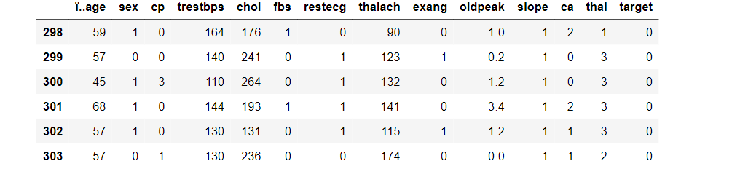
Dataset Overview

Slide 8
Steps To Analyse
Step 1 - Install the required packages
Step 2 - Read the file
Step 3 - Build and Clean corpus
Step 5 - Build the Bar Plot for Diseased and Not Diseased.
Step 6 - Obtain Diseased Scores
Step 7 - Obtain the Bar Plot of Result

Slide 9
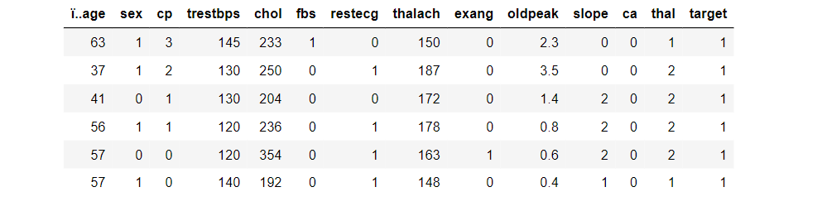
Head (dataset)

Slide 10
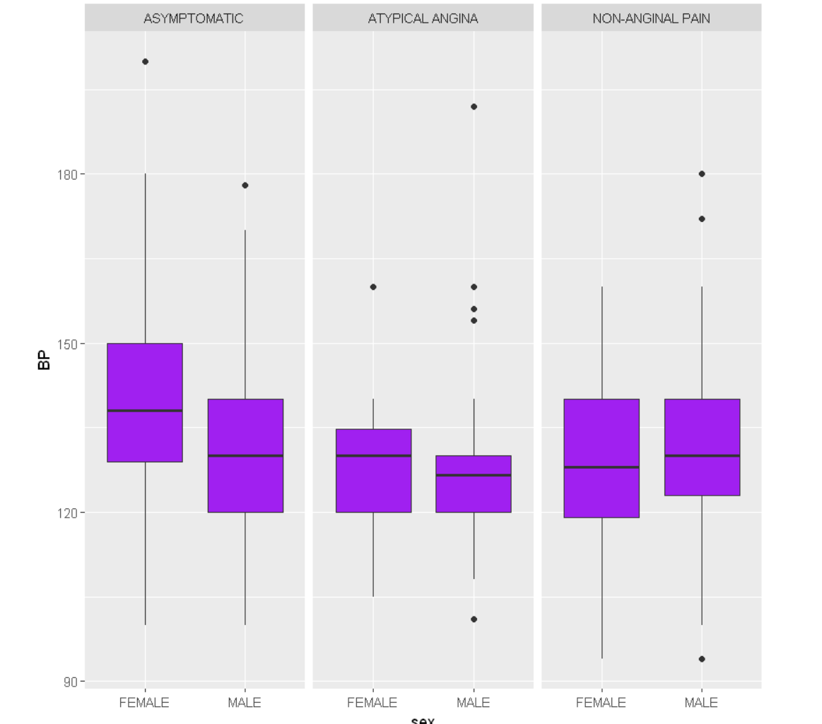
RESULTS

Slide 11
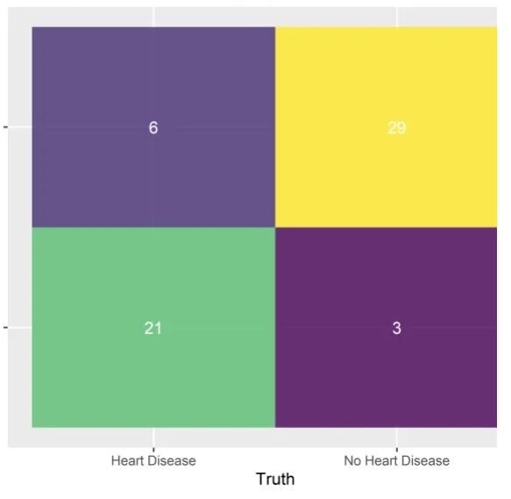
RESULTS

Slide 12
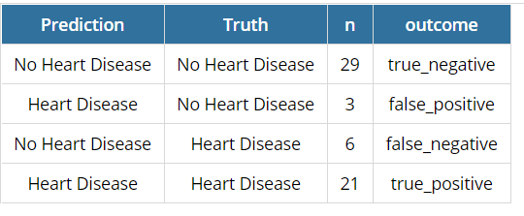
RESULTS

Slide 13
REFERENCE
Barnathan ES. Has lipoprotein ‘little’ (a) shrunk? JAMA.1993; 270:2224–2225.
Marcovina SM, Koschinsky ML. Lipoprotein(a) as a risk factor for coronary artery disease. Am J Cardiol.1998; 82:57U–66U.
Craig WY, Neveux LM, Palomaki GE, et al. Lipoprotein(a) as a risk factor for ischemic heart disease: meta-analysis of prospective studies. Clin Chem.1998; 44:2301–2306.
Nguyen TT, Ellefson RD, Hodge DO, et al. Predictive value of electrophoretically detected lipoprotein(a) for coronary heart disease and cerebrovascular disease in a community-based cohort of 9936 men and women. Circulation.1997; 96:1390–1397.
Ridker PM, Stampfer MJ, Hennekens CH. A prospective study of lipoprotein(a) and the risk of myocardial infarction. JAMA.1993; 270:2195–2199.
Schaefer EJ, Lamon-Fava S, Jenner JL, et al. Lipoprotein(a) levels and risk of coronary heart disease in men: the lipid research clinics coronary primary prevention trial. JAMA.1994; 271:999–1003.
Wald NJ, Law M, Watt HC, et al. Apolipoproteins and ischaemic heart disease: implications for screening. Lancet.1994; 343:75–79.

Slide 14
CONCLUSION
Subjective extracts provide a better accuracy of disease prediction.
Early prediction can prevent major Risk.
Several approaches use algorithms like Naïve Bayes, Logical Regression, etc. to perform data analysis.

Slide 15
THANK YOU
-

